Slide 1
Session Objectives
Align on Project goals
Agree on joint workstream objectives
Understand the existing technology elements and plans with relation to customer journeys
1 - How do measure adoption and implementation
2 - #Speak to Saad and Secil for CDP. (Integrated by CRM. Backend to masters consent and data privacy, customer data(?)/MDM. Platform to manage accounts/login, SSO, C360 platform (eventually))- Custom built
Behavioural segment is being actively captured (France good, Spain just starting for example), validating the ABCD.
NL progress on adoption ladder

Slide 2
Project has 3 main workstreams underpinned by strong Project Management
March |  |  | April | April |  |  | May | May
15 | 22st (1) | 29th (2) | 5th (3) | 12th (4) | 19th (5) | 26th (6) | 3rd (7) | 10th (8) | 17th (9) | 24th (10)
Project Management
Create Customer journey maps
1
Phase 1b
Build & Test Regional CJ Maps
Phase 1c
Detailed Localization of CJ Maps for Germany, UK and France
Phase 1d
Initiate Localization of CJ for small markets
Phase 1a
Foundations for CJ Maps
Align maps with CRM
2
Phase 2a
Define Alignment between CJ Maps & CRM
Phase 2b
Build action plan to operationalize alignment
Mobilization
Build Customer journey map understanding
3
Phase 3a
Build Tactic Plan
Phase 3b
Build e-learning module
Phase 3c
Train the Trainer (CJ Market Champions)

Slide 3



CURRENT
DESIRED
Behaviour Change
Uses a very broad spectrum of products including JAKs
Uses very recently launched products
Able to talk extensively about new and pipeline treatments
Willing to act ahead of guidelines
Tries JYSELECA with some patients
(After they have gained experience) Expand JYSELECA use in a wider range of patients in preference to other JAKs
Unmet Need
Research
1st Rx
Prescribes
Advocates
Adoption Stage
Uses a wide variety of treatments 1st line, including JAKs
Reflects on early JYSELECA experience & positive efficacy outcomes compared with other JAKs
Prescribes JYSELECA as their ‘go to’ JAK
Shares positive experiences with colleagues
Advocates JYSELECA as JAK of choice
To demonstrate that the burden of the disease including side effects is more significant that currently thought.
Galapagos Goal
Highly competitive environment with comparisons between treatments hard to make.
Treatment inertia and need to overcome mindset shift
Barriers
<Insert Message related to existing treatment data>
<Branded messaging introduced>
Messages
Message Source
KOL Video
Study x
Guidelines
Be clear to markets that this is the starting point –with local segmentation preference applied, show why we’re focusing one segment, show research

Slide 4


Current called “1-5” stages
BNLX have 7 steps – being migrated
RA-specific
Behavioural segments being implemented
Messages being related to ‘key messages’
FR: use surveys for capturing a HCPs behavioural segment
Key messages in CLM will be captured (+reaction is available)
Messages are translated – mapping method in CRM to align global English messages to local translated messages.
‘Theme’ – above aggregate ‘Safety’ ‘Efficacy’ etc.
Prescribes JYSELECA to identified patient & monitors
Identifies a suitable patient & invites them for review & discussion of options
Starts to use JYSELECA as first line JAK inhibitor
Reviews list of potential patients with first TNF failure to discuss JYSELECA benefits
Monitors feedback & safety signals in JYSELECA patients
Attends a peer-to peer discussion with local colleagues about how JYSELECA is being incorporated into the guidelines
Expands the use of JYSELECA to different types of patients so ultimately JYSELECA becomes JAK of choice
Prescribes JYSELECA for some patients where safety & simplicity are important
Uses JAKs very late line – TNFs first
Gains depth of experience in patients where safety is a concern
Attends a discussion with local expert about their experiences with JYSELECA & its safety profile
Advocates JYSELECA as JAK of choice
Prescribes JYSELECA for some patients where safety is the main concern
Uses a variety of products based on patient need & guideline recommendations
Shares positive experiences with colleagues
Attends a peer-to peer discussion with local colleagues about their experiences with JYSELECA & its safety profile
Prescribes JYSELECA as their ‘go to’ JAK
Occasionally uses JAKs but not consistently
Reflects on early JYSELECA experience & positive efficacy outcomes compared with other JAKs
Uses a wide variety of treatments 1st line, including JAKs

Slide 5
CRM/Tech Workstream
Meeting 2

Slide 6


Behaviour Change
CURRENT
…
DESIRED
…
Unmet Need
Research
1st Rx
Prescribes
Advocates
Adoption Stage
#1
#2
#3
#4
#5
Galapagos Goal
Barriers
Messages
Message Source
Eg KOL video
Study X

Slide 7
Behaviour Change
CURRENT
Uses a very broad spectrum of products including JAKs
Uses very recently launched products
Able to talk extensively about new and pipeline treatments
Willing to act ahead of guidelines
DESIRED
Tries JYSELECA with some patients
(After they have gained experience) Expand JYSELECA use in a wider range of patients in preference to other JAKs
Unmet Need
Research
1st Rx
Prescribes
Advocates
Adoption Stage
#1
#2
#3
#4
#5
Mavericks: insert here
Pragmatists: insert here
Compassionates: Insert here
Galapagos Goal
Highly competitive environment with comparisons between treatments hard to make.
Treatment inertia and need to overcome mindset shift
Barriers
Mvrks
Messages
Prgmts
Cmpsts
Message Source
KOL Video
Study x
Guidelines

Slide 8

Behaviour Change
CURRENT
…
DESIRED
…
Unmet Need
Research
1st Rx
Prescribes
Advocates
Adoption Stage
#1
#2
#3
#4
#5
Mavericks: insert here
Pragmatists: insert here
Compassionates: Insert here
Galapagos Goal
Highly competitive environment with comparisons between treatments hard to make.
Treatment inertia and need to overcome mindset shift
Barriers
Science First
Messages
Patient first
Familiarity
first
Message Source
KOL Video
Study x
Guidelines

Slide 9
Journey Principles
What is the priority?
Practical / Pragmatic
Reflect brand plan and prioritization of activation
Simple
Addressing customer needs and preferences – leveraging market research (content, channel, style, time)
Actionable today = channel maturity, content is there, or where consent is required
Powered by Insight & data (try to combine where possible to see 360 view)
‘Aligned to CRM/CDP’
Various access points (into journey)
Linked to key events
Journeys are connected and not in isolation
Leverages digital and physical touchpoints
Based on fact, not feeling (where possible)

Slide 10
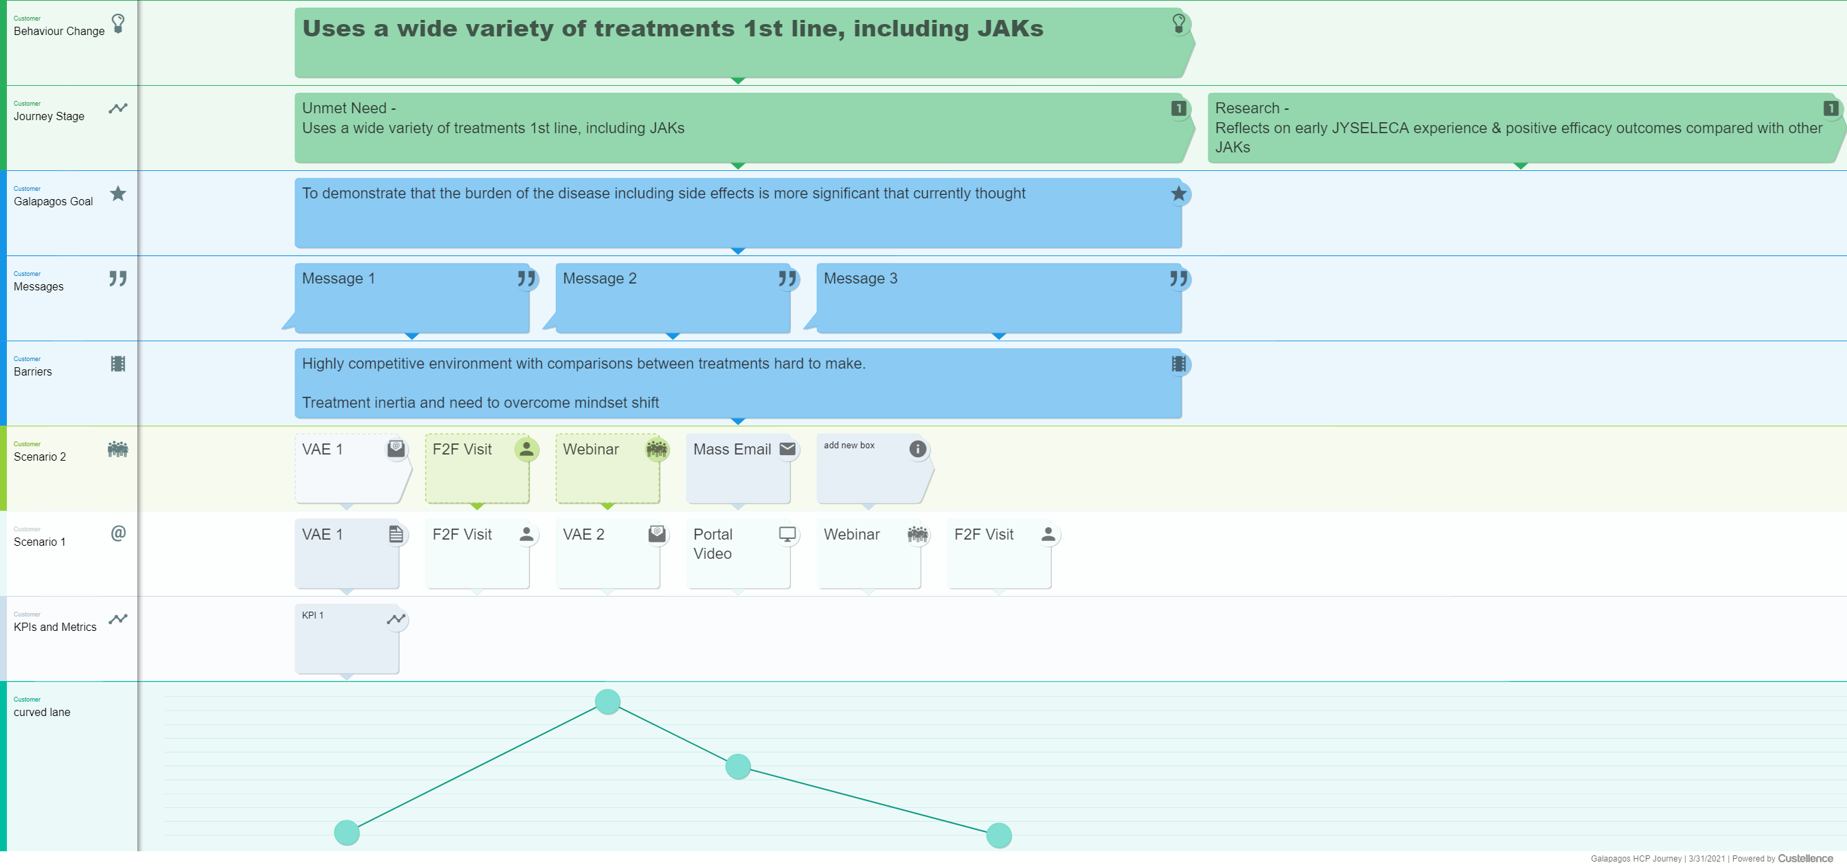



Tool Comparison
Easily Editable – Basic Changes
Easily Editable – Structural Changes
Learning Curve
Live Collaboration
Flexibility
Readability
Full map visualisation
Guided Journey Creation
Cost

Slide 11
Project Plan

Slide 12

Workstream Plan
April | April |  |  | May | May
5th (3) | 12th (4) | 19th (5) | 26th (6) | 3rd (7) | 10th (8) | 17th (9) | 24th (10)
Scope & Deliverables Definition
Adoption Journey Alignment
Journey Visualisations & Measurement
CRM Field Requirements
Journey Visualisation
Journey Measurement
Adoption Journey Field Alignment Meeting
Ladder <-> CRM
Mapping the existing CRM fields with the Adoption Ladder
Identifying whether additional fields could be added to CRM to better represent the journeys
CRM field alignment review
30 mins
Requirements sign-off for next sprint
30 mins
Ideation Session
60-90 mins
Approach review
45 mins
Ideation Session
60-90 mins
Approach review
45 mins
Deliverable 1: Sprint Requirements
Deliverable 2: Simple guide to demonstrate how the Adoption Ladders and CRM will be aligned
Deliverable 3: Outline of the data & analysis quick wins approach for measuring Journey/Ladder execution
Deliverable 4: Overview of the ‘next steps’ for operationalising/visualising Journeys – such as a MyInsights dashboard

